Slide 1


Git and GitHub
By Zeeshan Sarfraz

Slide 2



Content Layout
- Version Control System (VCS)
- Introduction to Git
- Git installation and commands
- Introduction to GitHub
- GitHub Setup
- Activity
- Q/A

Slide 3

Problem: The Mess Without Version Control
- Multiple File Copies
- Overwriting Issues
- No Change History
- Collaboration Chaos

Slide 4

The Problem in Detail
- Lack of Traceability
- Conflicting Edits
- Time Wasted

Slide 5
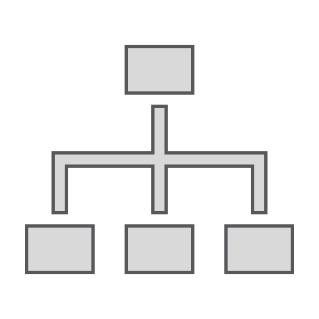
Solution: Version Control Systems (VCSs)
- Help track/manage/distribute revisions
- Examples: RCS, CVS, SVN, Git

Slide 6
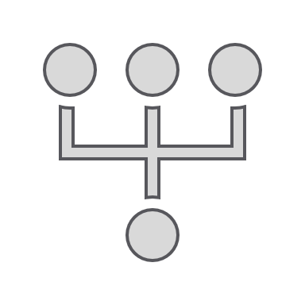
Git: A Leading Distributed VCS
- Distributed Nature
- Branching and Merging
- Performance and Collaboration
- History and Integrity

Slide 7

Installing Git
Download: http://git-scm.com/downloads

Slide 8
Git Setup
$ git --version
$ git config --global user.name "<YOUR_NAME>"
$ git config --global user.email "<YOUR_EMAIL>"

Slide 9

Diving into Git
$ git init
$ mkdir workspace
$ cd workspace

Slide 10
Adding Files & Committing
$ git add <filename>
$ git commit -m "Your commit message"

Slide 11
Git Life Cycle
- Uncommit Changes: $ git reset
- Working with Branches: $ git branch <branchname>

Slide 12
Merging Branches
$ git merge <branchname>
$ git checkout main

Slide 13

Introduction to GitHub
- Version Control Hosting Services
- Examples: SourceForge, Bitbucket, GitLab, GitHub

Slide 14
Git vs. GitHub
- Git = Your Personal Notebook
- GitHub = A Shared Library/Publishing Platform

Slide 15
GitHub Signup
1. Visit github.com and Sign Up
2. Fill in your details
3. Verify your email

Slide 16
Creating a Repository
$ git remote add origin https://github.com/<USERNAME>/<REPO>.git
$ git push -u origin main

Slide 17
Cloning a Repository
$ git clone https://github.com/<USERNAME>/<RepoName>.git

Slide 18
Git Push & Git Pull
- Push: $ git push origin main
- Pull: $ git pull origin main

Slide 19
Pull Request (PR)
- Code Review
- Collaboration
- Quality Control

Slide 20
How It Works
1. Create a Branch
2. Commit & Push
3. Open a Pull Request
4. Review & Merge

Slide 21
Activity
1. Create a new branch
2. Add another .html file
3. Modify index.html
4. Commit & Create PR
5. Review and Merge

Slide 22
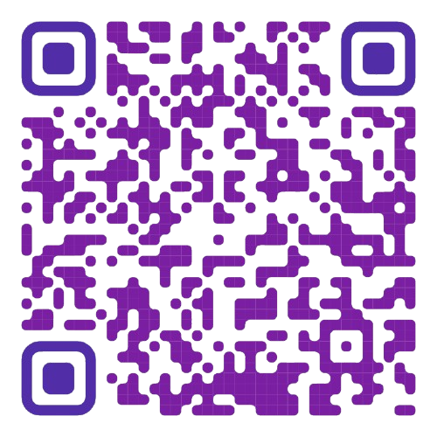
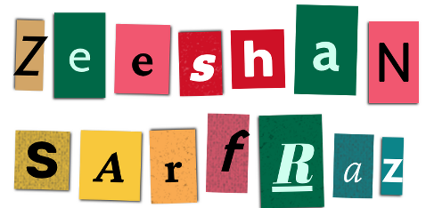
Any Questions?
Thank You!
Email: zeeshan.sarfraz@atrons.net
LinkedIn: www.linkedin.com/in/xeeshan-zs/

